Slide 1
Why you should join your Local Optical Committee? An introduction to work of the LOC
Name and LOC

Slide 2
Introduction to the work of the LOC and LOCSU
Local Optical Committees (LOCs) are recognised by the NHS as the representative organisation for optometrists and dispensing opticians delivering ophthalmic services such as sight tests and other eye health services.
LOCSU (the Local Optical Committee Support Unit) is the national support unit in England for the 74 LOCs.

Slide 3
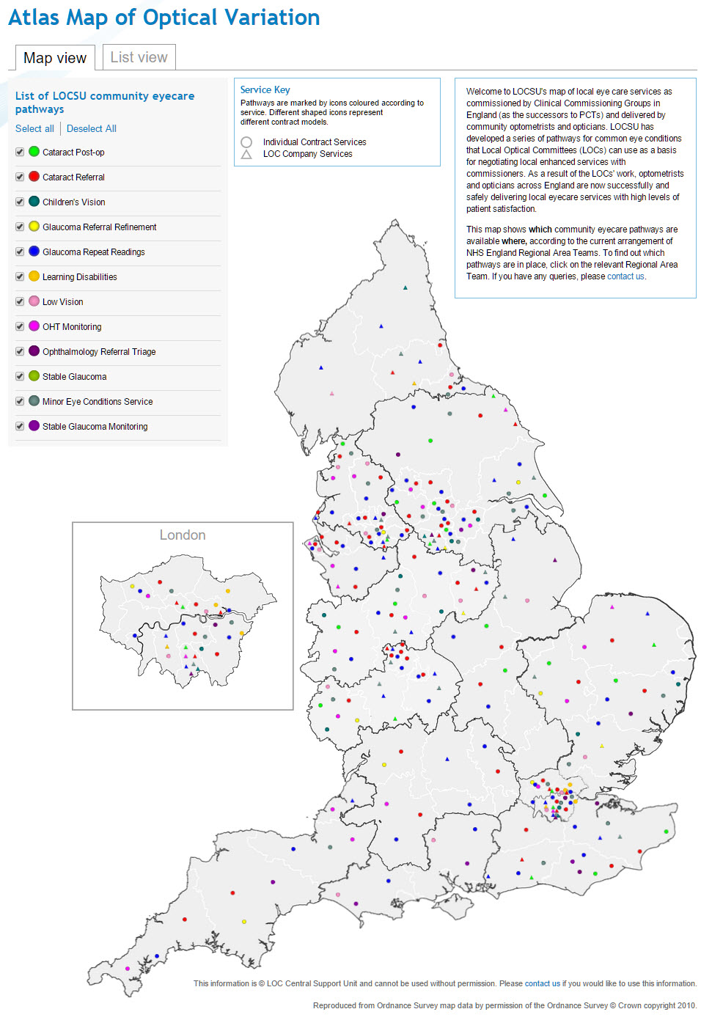
Introduction to the work of the LOC and LOCSU
LOCs supported by LOCSU work with local commissioners to develop local eye health services which are more accessible for patients, cost effective for the NHS and delivered through optical practices
LOCSU’s website has a directory of eye health services for England

Slide 4
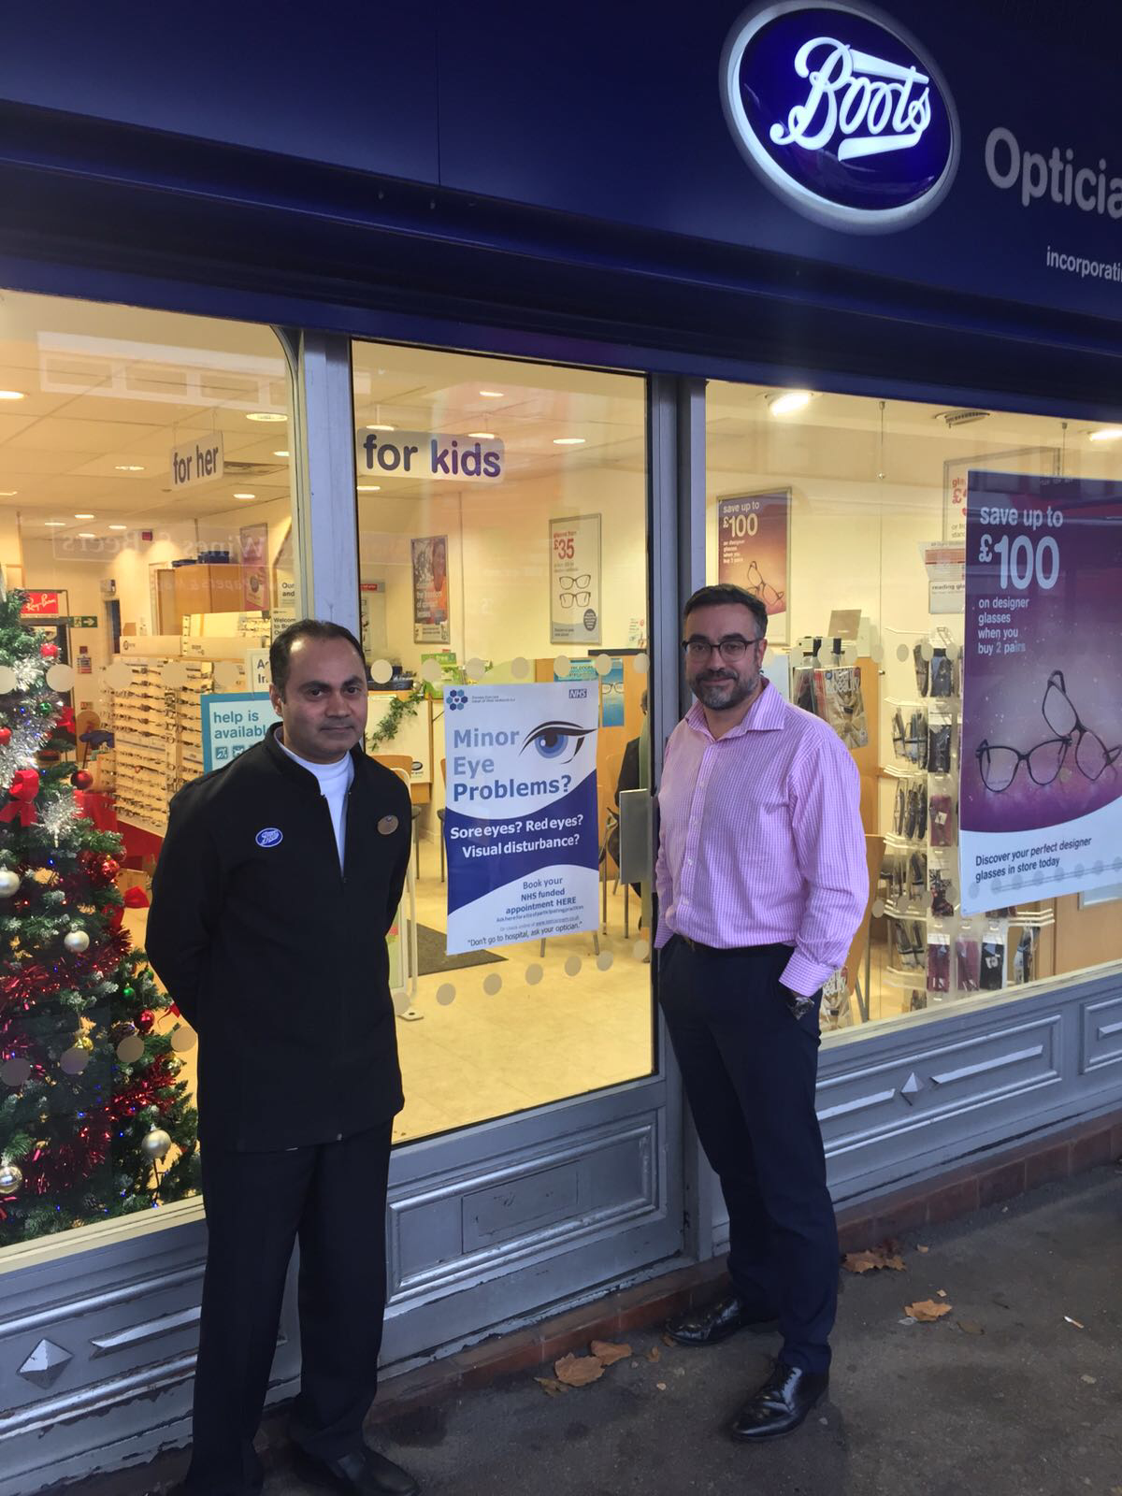
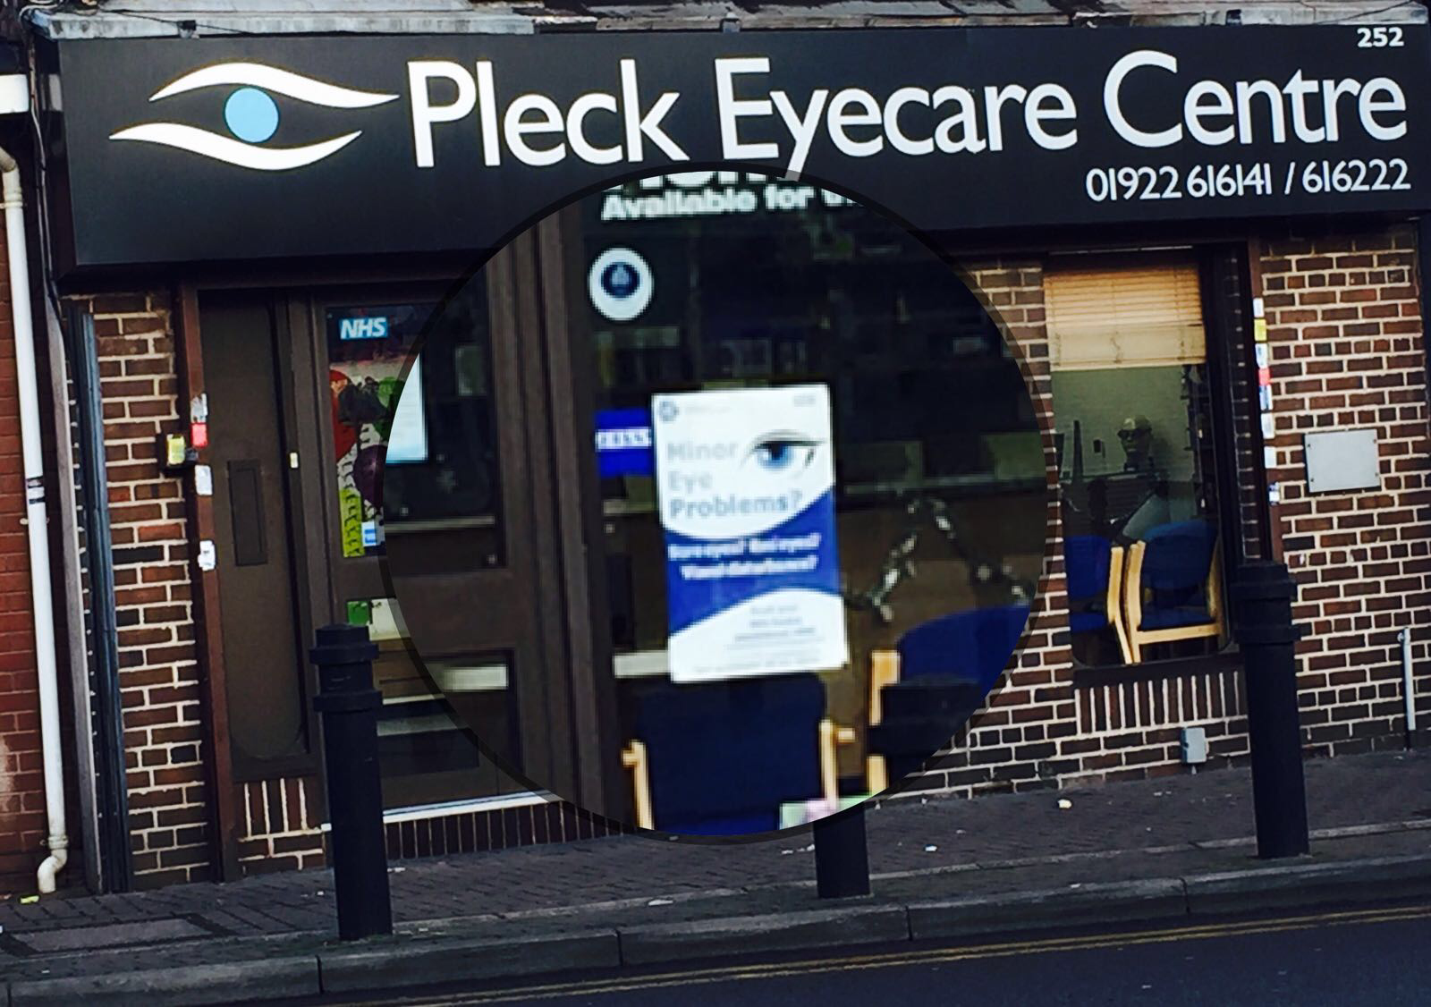
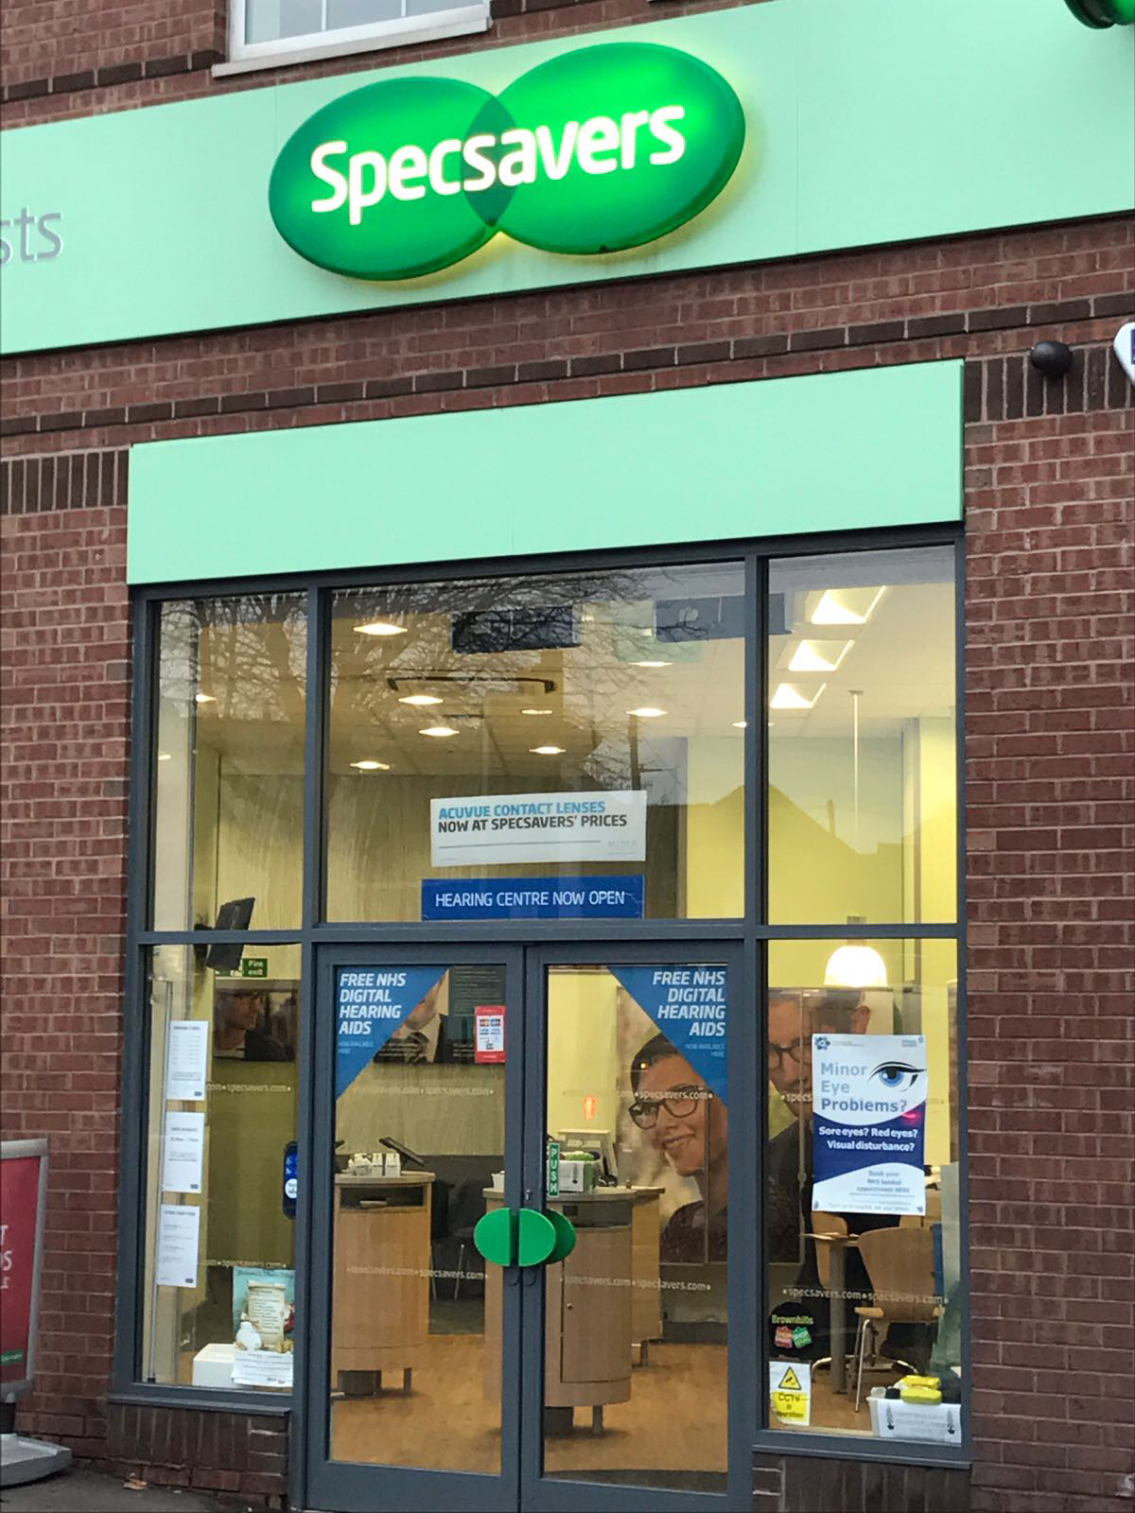
Extended Primary Eye Care Services delivered by every type and size of practice

Slide 5
Your LOC (LOC to add local details)
List of 74 LOCs in England
LOC Meetings/AGM
Attending as an observer
Buddy system
Jargon Buster
List primary care services
Primary Eyecare Company role

Slide 6
Your LOC – (LOC to add local details)
WOPEC training
CET
LOCSU Induction Training
National Optical Conference
Leadership Skills for Optical Professionals

Slide 7
LOCSU Channels
LOCSU Newsletter
LOCSU Twitter
LOCSU Facebook
LOCSU Communications

Slide 8
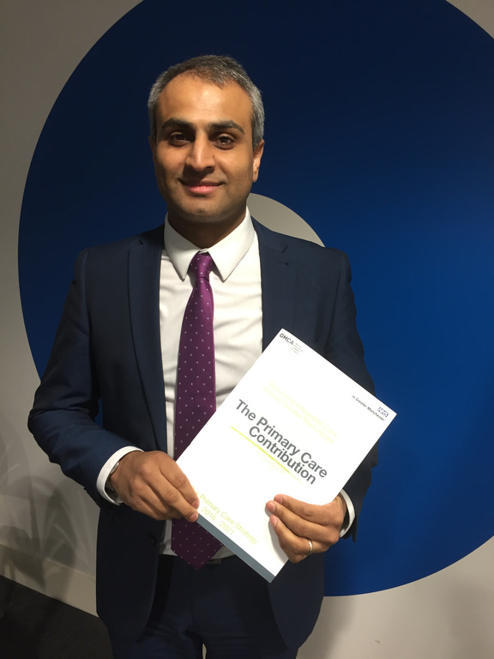
Contributors
Dharmesh Patel is an independent optometrist
He is a LOCSU Commissioning Lead
Chair of the Greater Manchester Local Eye Health Network
Primary Care Provider Lead for GM’s Health Devolution
Chief Officer of Primary Eyecare Services, the largest Primary Eyecare company in the country

Slide 9
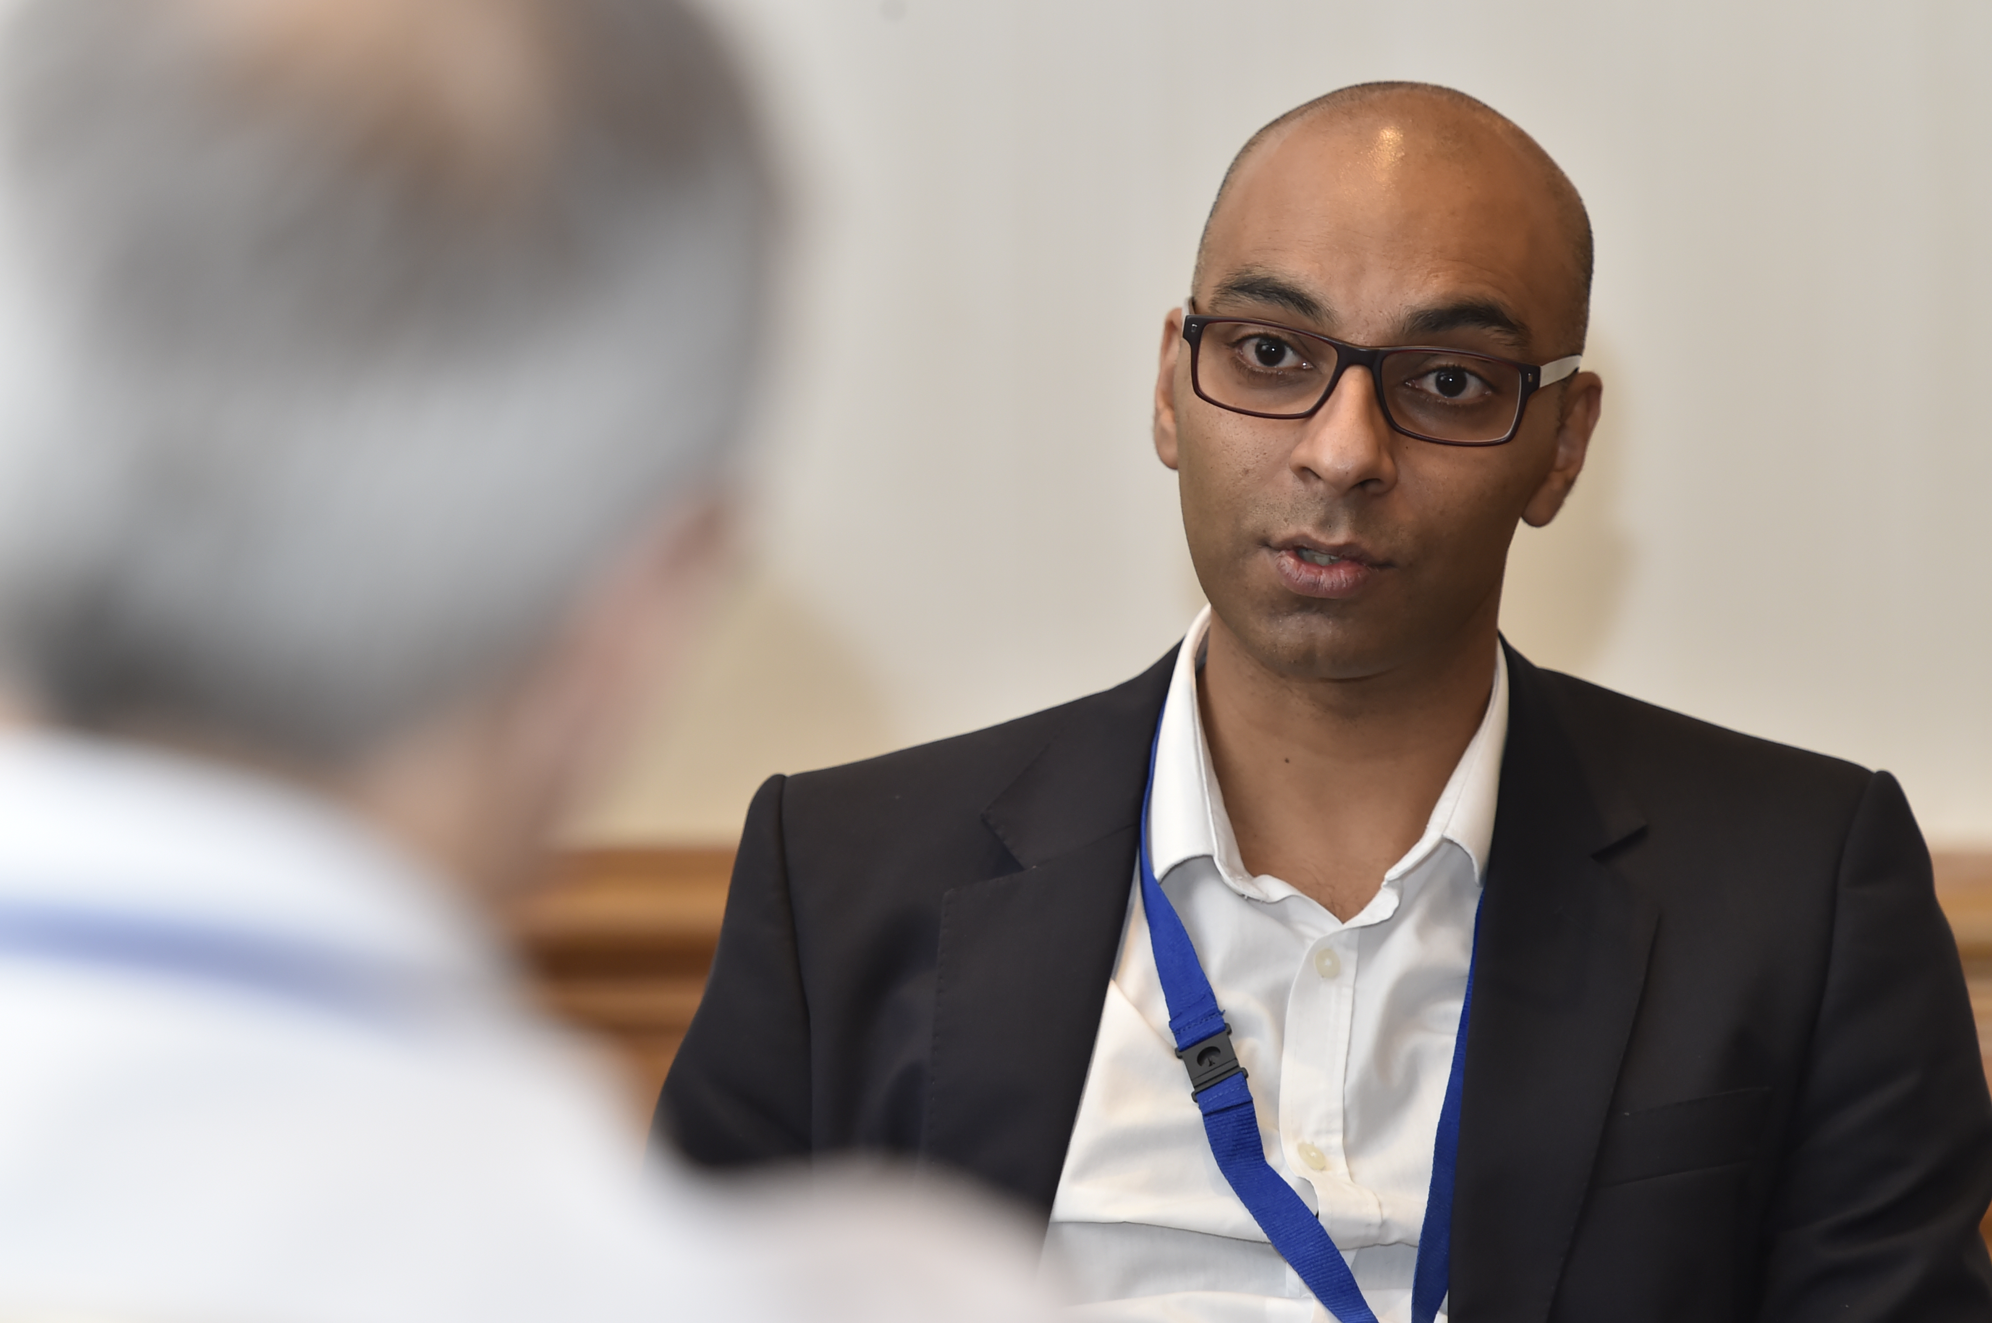
Contributors
Rupesh Bagdai Rupesh qualified as an optometrist in 1998.
He was an active member of Cheshire LOC between 2009-2017.
LOCSU Commissioning Lead
Chair of Cheshire & Merseyside Local Eye Health Network
Chief Governance Officer of Primary Eyecare Services.

Slide 10
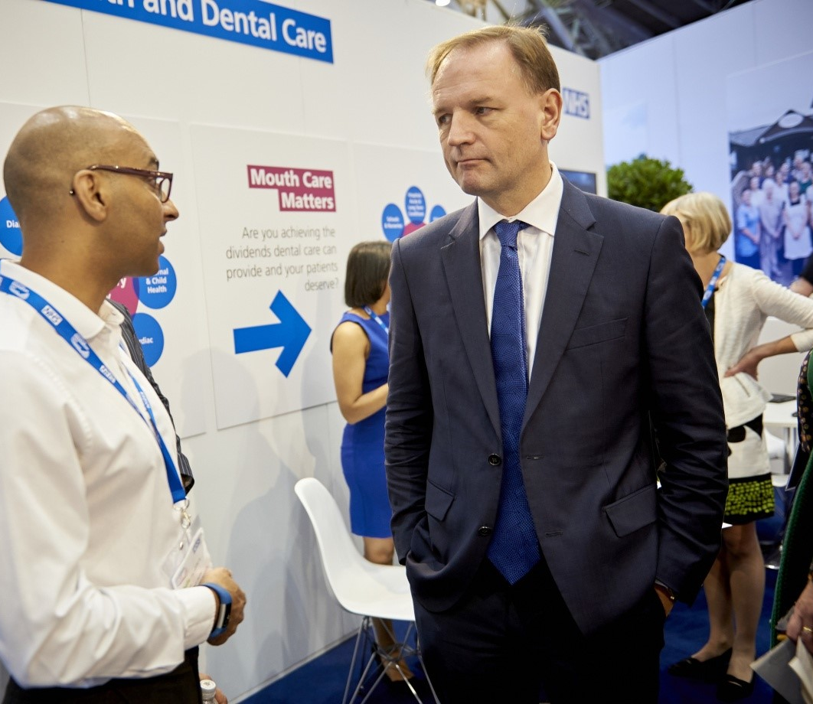
Don’t take our word for
Rupesh presented findings at an NHS Expo outlining how eye examinations for vulnerable groups can generate significant savings in expensive social care
He is pictured (left) speaking to NHS CEO Simon Stevens – architect of the current health reforms – about the role of eye care

Slide 11
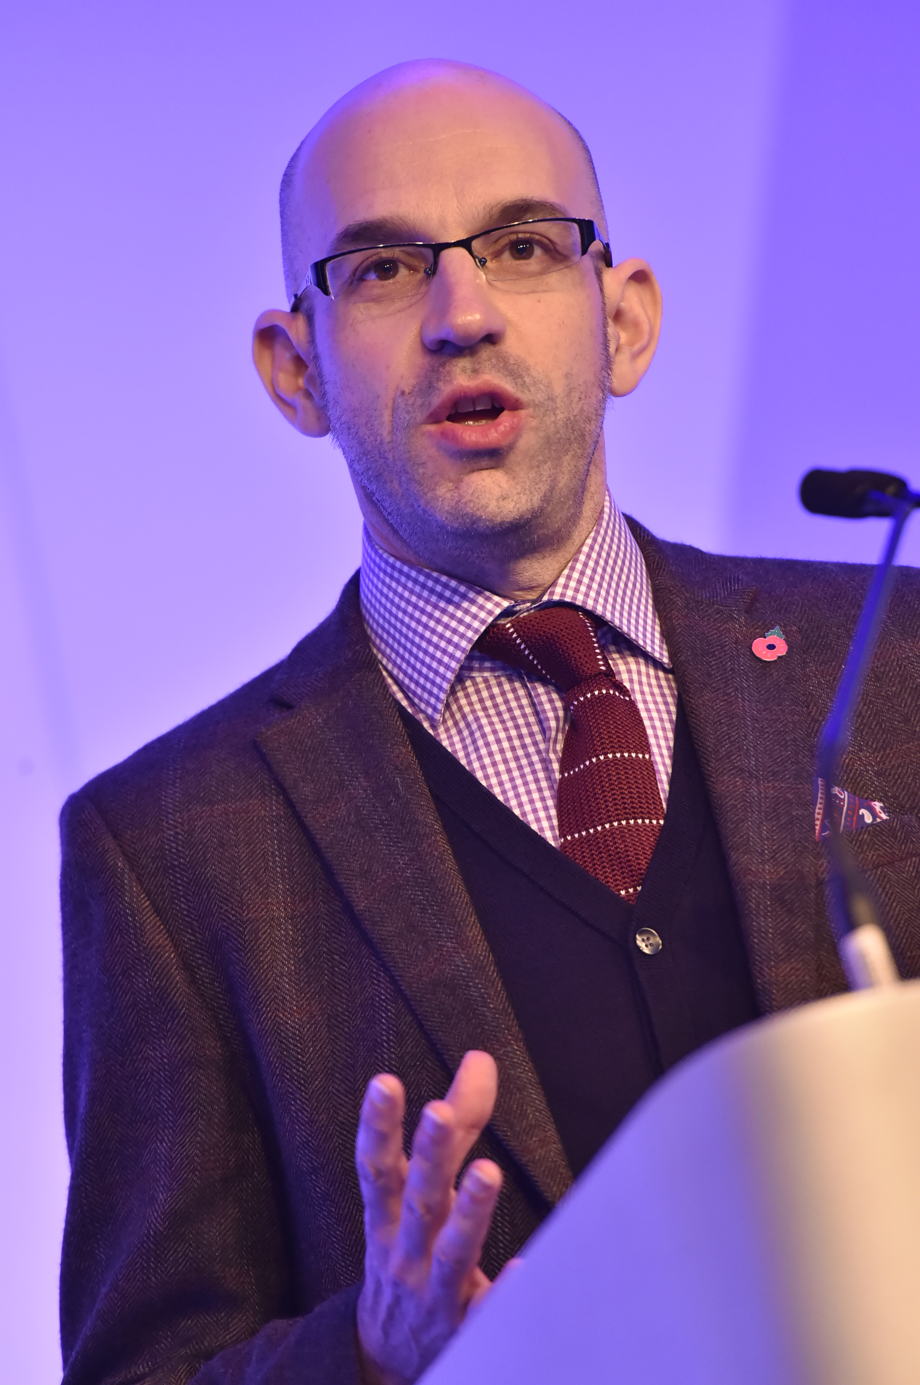
Contributors
Richard Whittington is Chief Operating Officer of LOCSU
He is an experienced CCG Director and Acute Trust Director with extensive commissioning and service redesign experience
He led the initial commissioning of primary care ophthalmic service across a range of South East London PCTs and CCGs
Richard has worked in and across all healthcare and care sectors and has a particular expertise in service change, organisational change and commissioning service delivery

Slide 12
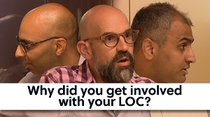
Videos
Why did you get involved with your LOC?
What do you get out of being on an LOC
Full video

Slide 13
Questions & Answer session

Slide 14
Contact
LOC Contact email and website
www.locsu.co.uk
info@locsu.co.uk

